Slide 1

California Housing Market Analysis
Group 2: Tommy Greve, Erik Lapszynski, Ariel Stanalonis, & Zach Vozzo
Notes:
Ariel

Slide 2
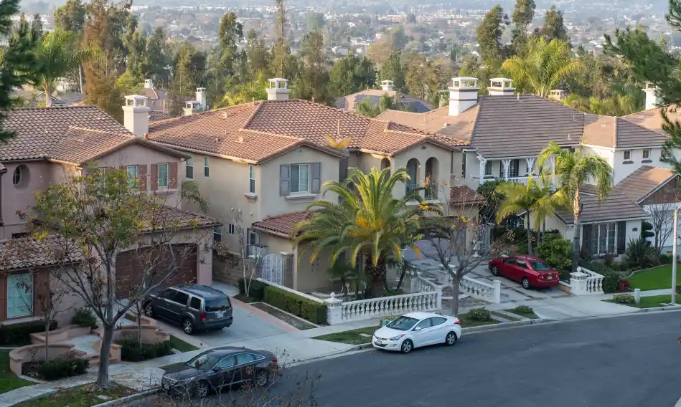

Table of Contents
Project Motivation and Background
Data Description
Data Preparation Activities
Enterprise Miner Models
Results and Findings
Managerial Implications and Conclusions
Notes:
Ariel

Slide 3
Project Motivation and Background
California population: 39 million (most in U.S.)
3 of the 10 largest U.S. cities (L.A., San Diego, San Jose)
5 more of the 50 largest U.S. cities (San Francisco, Fresno, Sacramento, Long Beach, Oakland)
California real estate market is the most chaotic in the U.S.!
Notes:
Tommy

Slide 4
Project Motivation and Background
More problems:
Not enough new properties built to satisfy demand
Shortage constantly drives up costs for renters and homeowners in heavily populated areas
Cali. has highest rate of functional poverty, second lowest rate of homeownership in U.S.
Notes:
Tommy

Slide 5
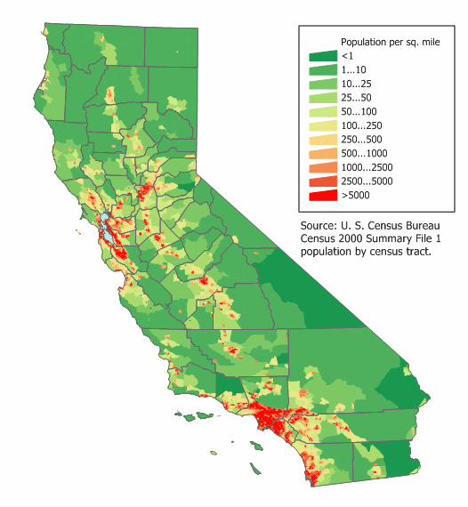

Project Motivation and Background
How can we discover the root causes of the California housing crisis and prevent it from continuing?
Are there any solutions to help prevent homeowners and renters in California from getting exploited by real estate agents and landlords?
Notes:
Tommy

Slide 6
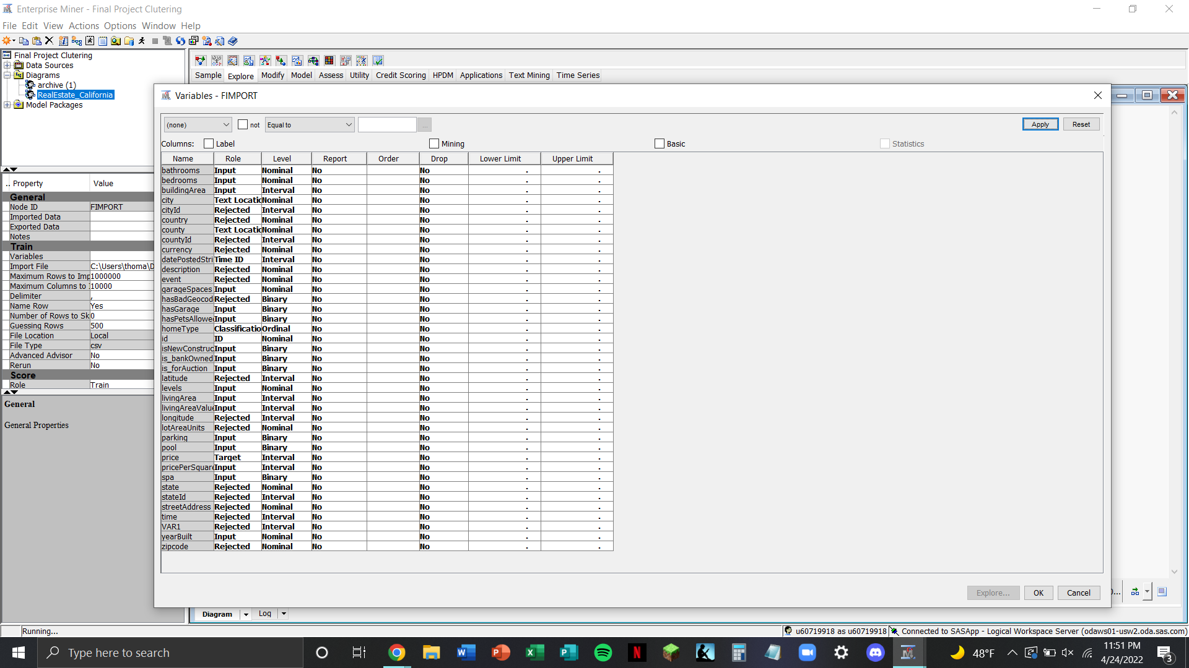
Data Description
Initial Kaggle dataset:
35,390 rows/listings
39 columns/dimensions
Mix of quant. & qual. data
Concerns:
Derivative columns
Pointless inputs
Assigning roles/levels
Notes:
Tommy

Slide 7
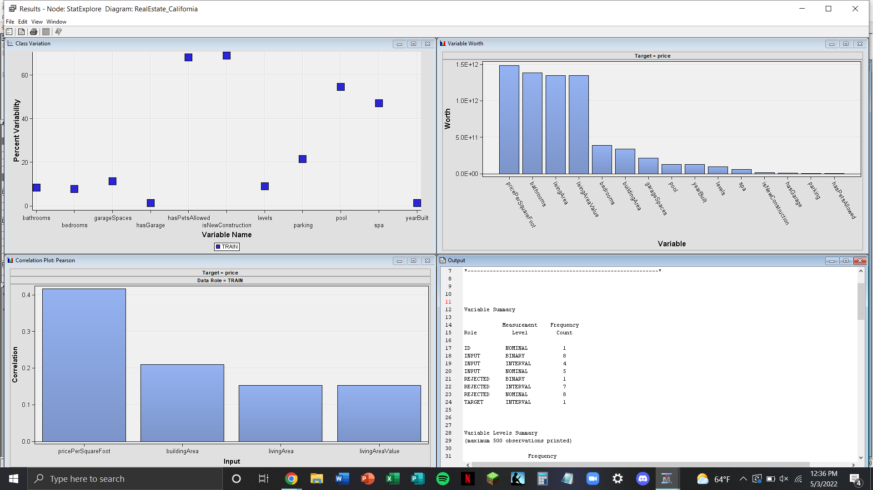
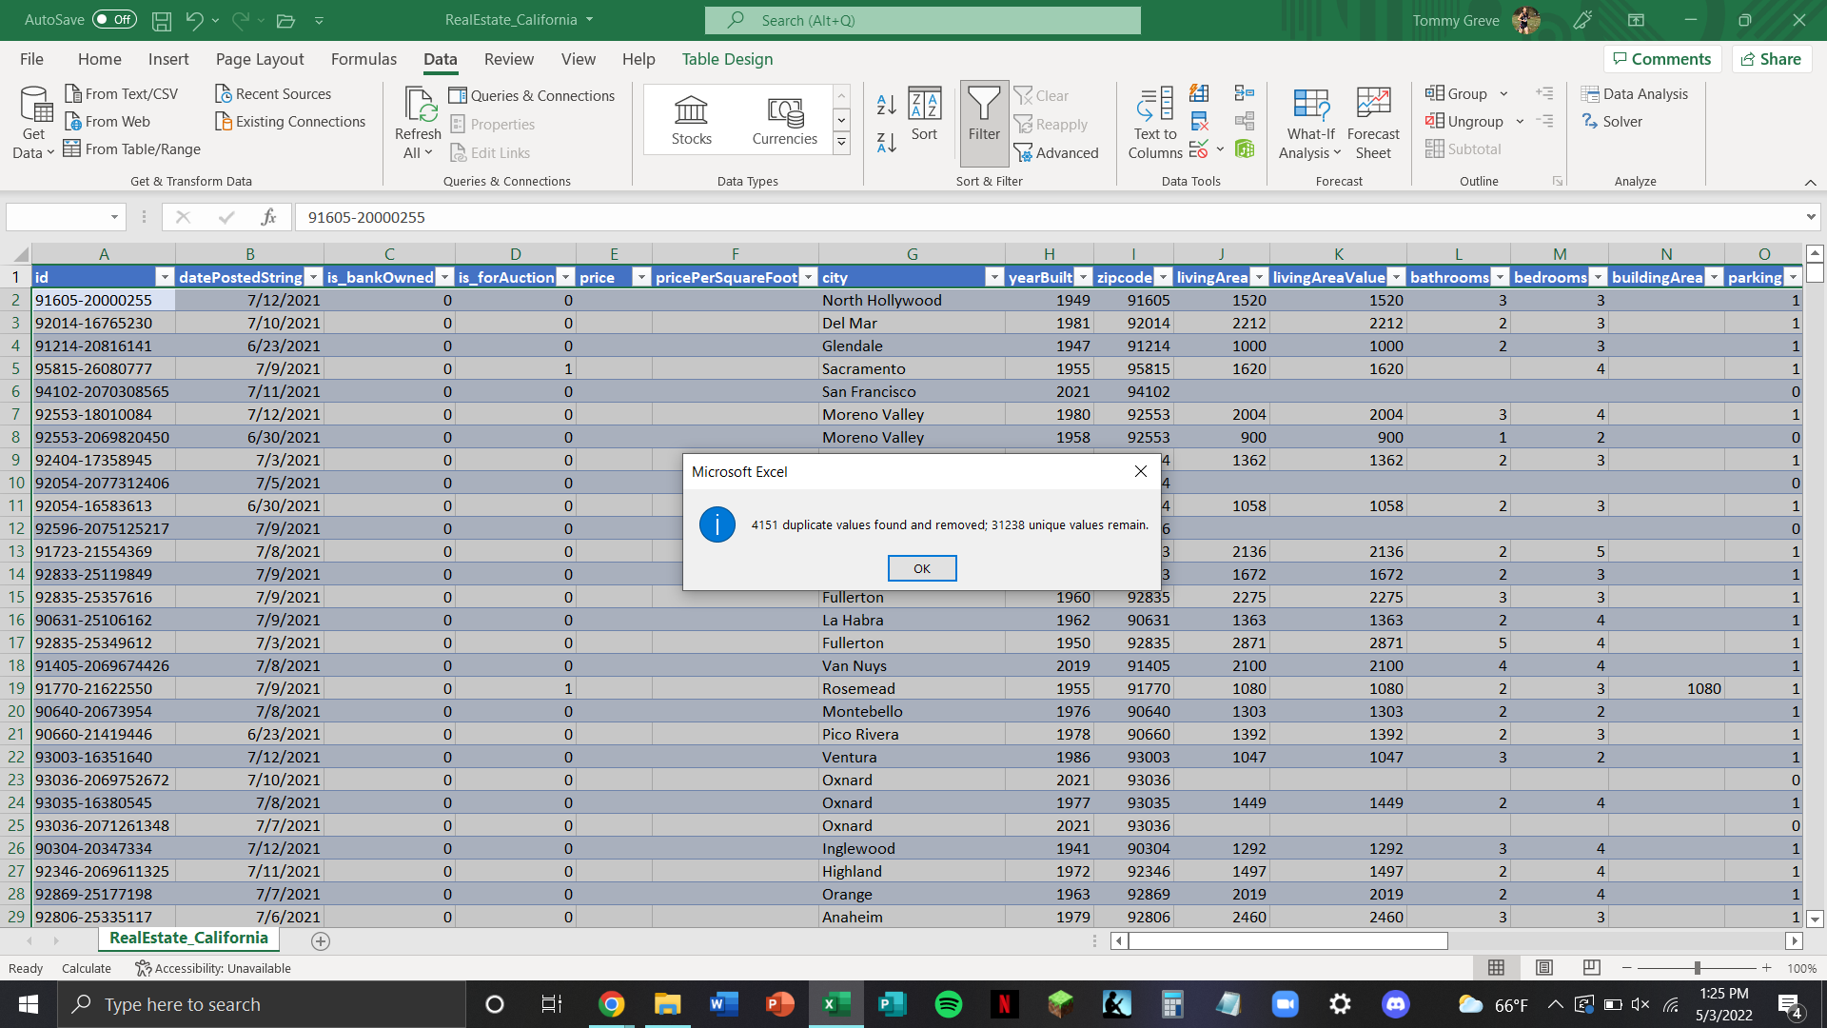
Data Preparation Activities
Cleaning/scrubbing data with Excel:
Eliminated duplicate listings
Imputed missing values
Filtered outliers (i.e. lots)
Standardizing levels
After cleaning:
3,152 unique rows/listings
17 columns/dimensions
Notes:
Tommy

Slide 8
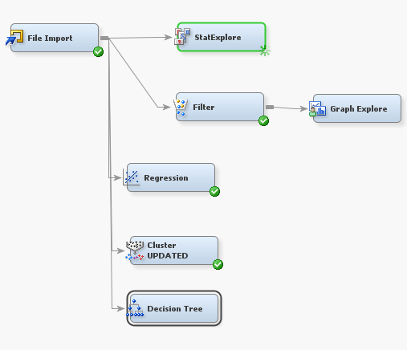
SAS Enterprise Miner Models
Exploring the data:
StatExplore
GraphExplore
Predictive models:
Linear regression
Cluster analysis
Decision tree analysis
Notes:
Erik

Slide 9
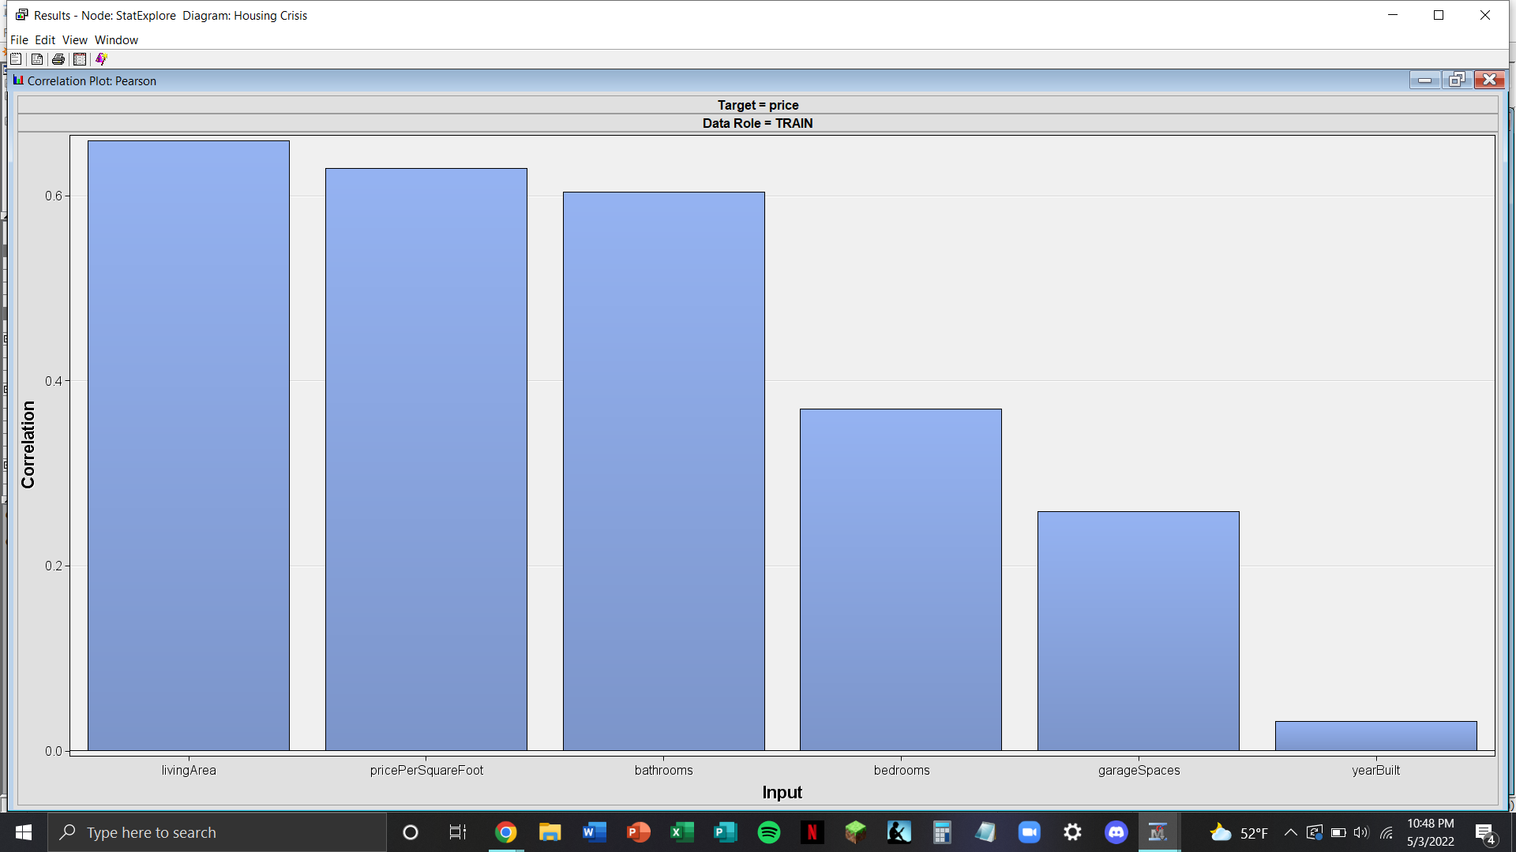
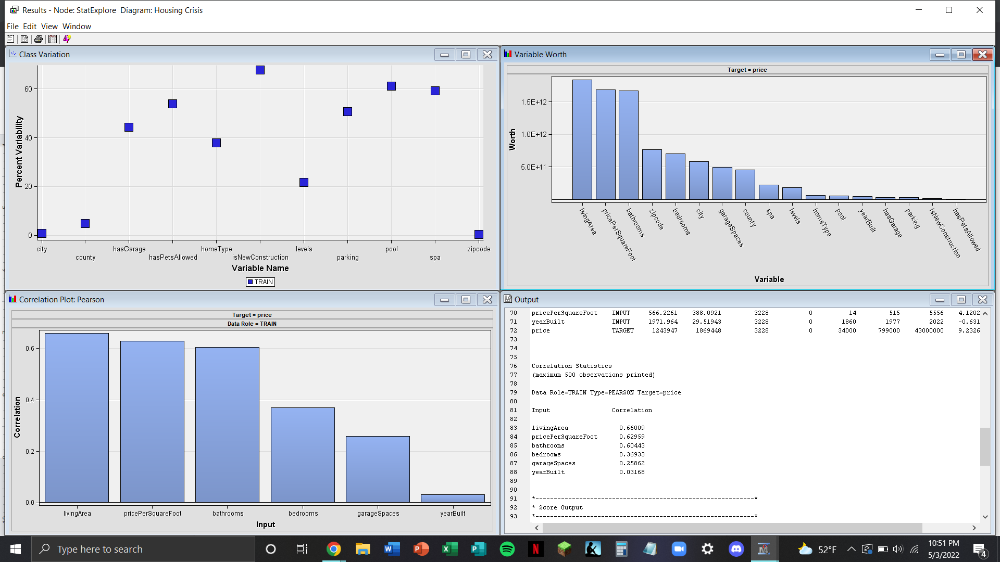
StatExplore Outputs
Notes:
Erik

Slide 10
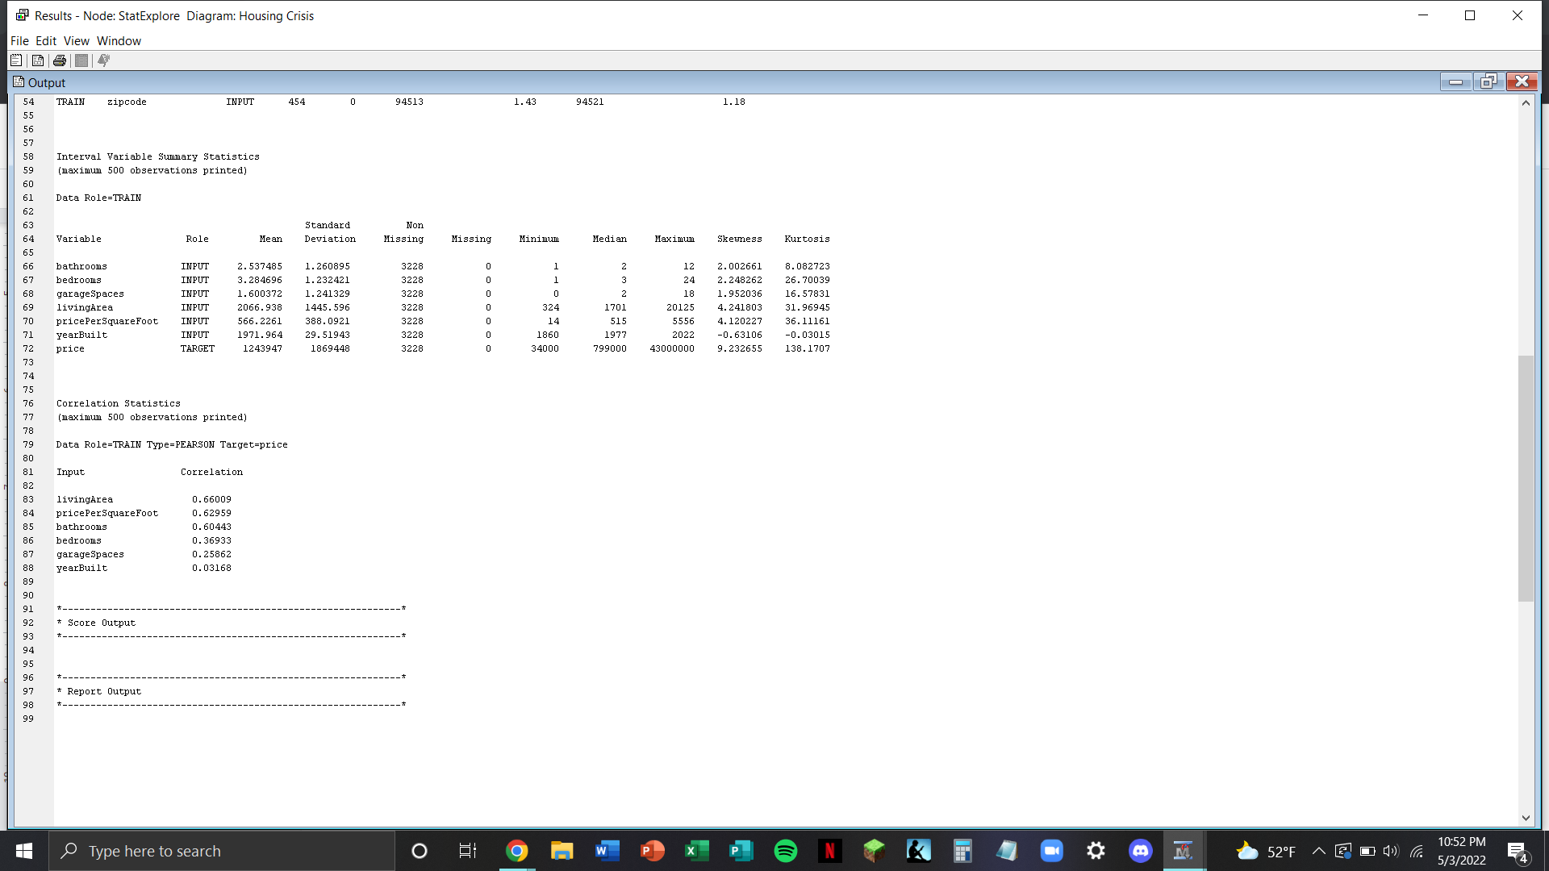
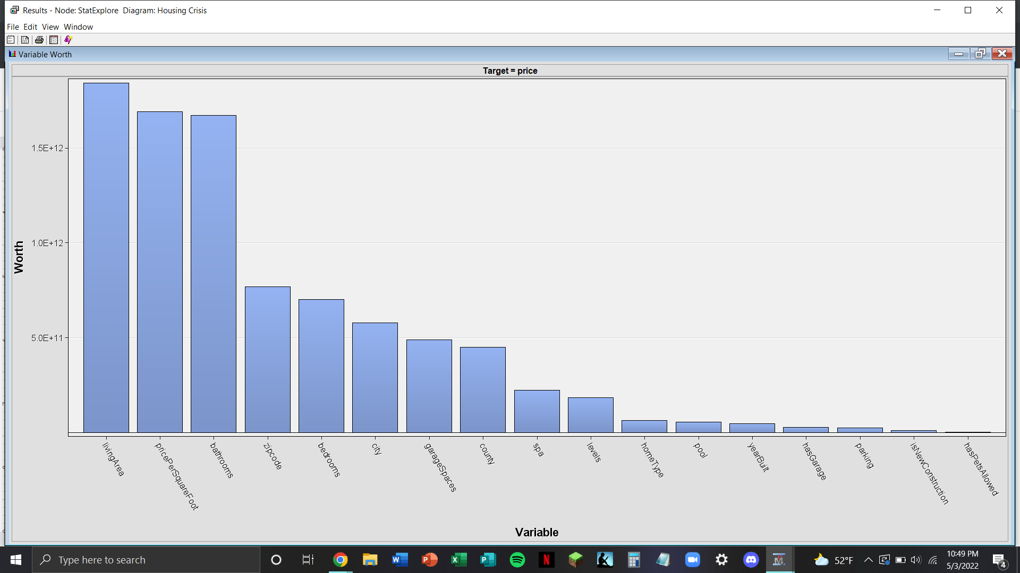
Notes:
Erik

Slide 11
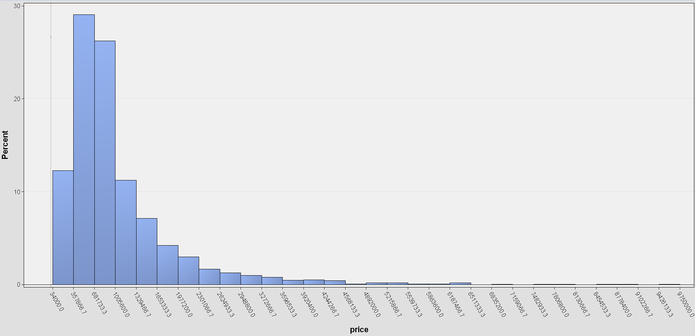
GraphExplore Output
Notes:
Erik

Slide 12
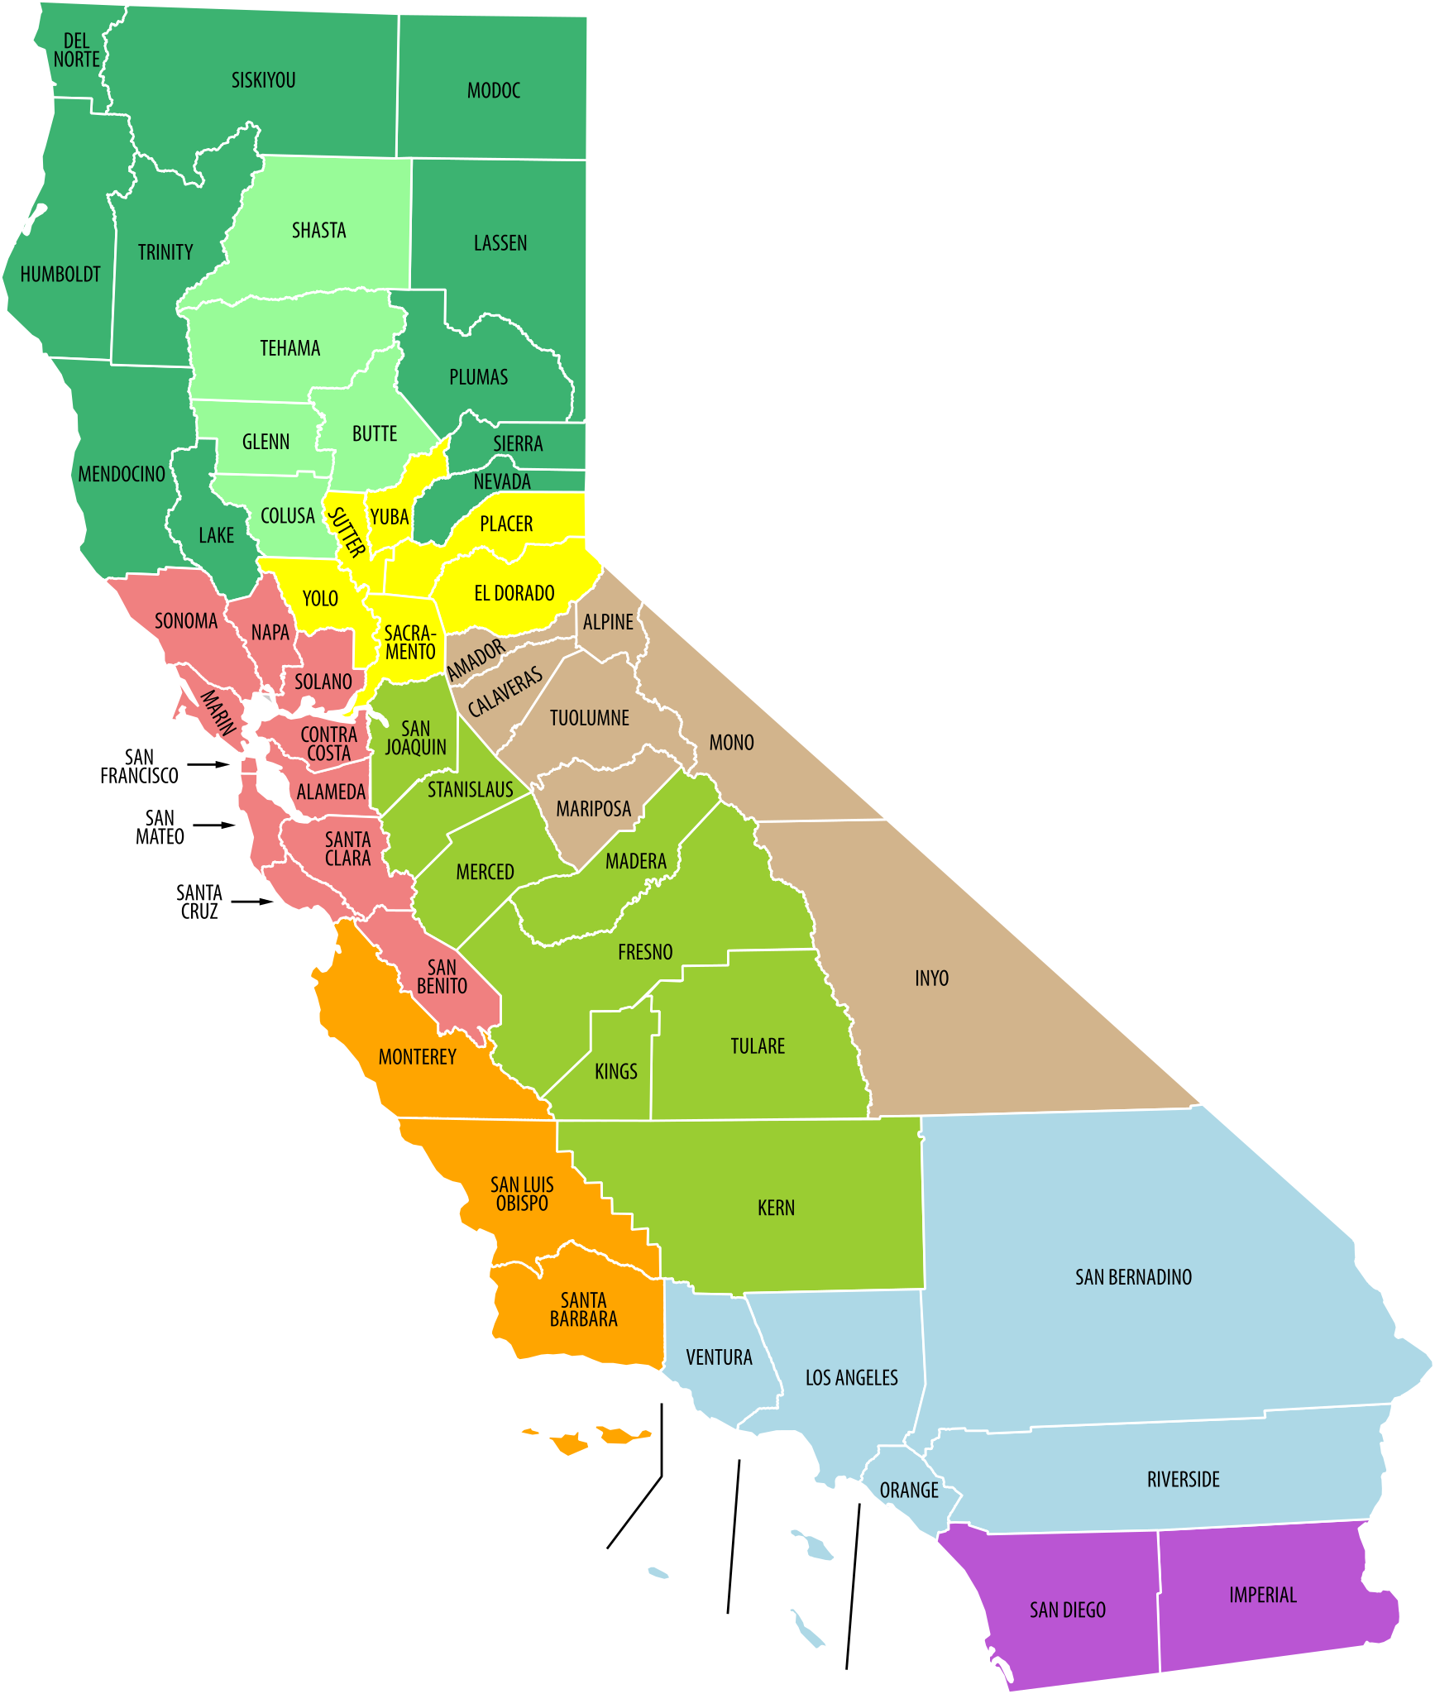
Linear Regression Analysis
Significant Variables
Bathrooms
City
Home type
Living area
Parking
Pool
Price per square foot
Spa
Notes:
Ariel

Slide 13
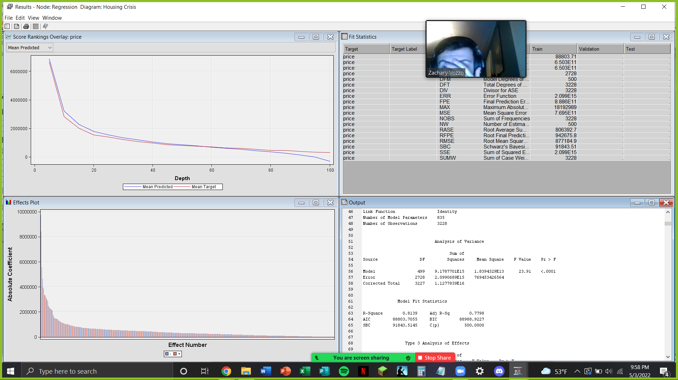
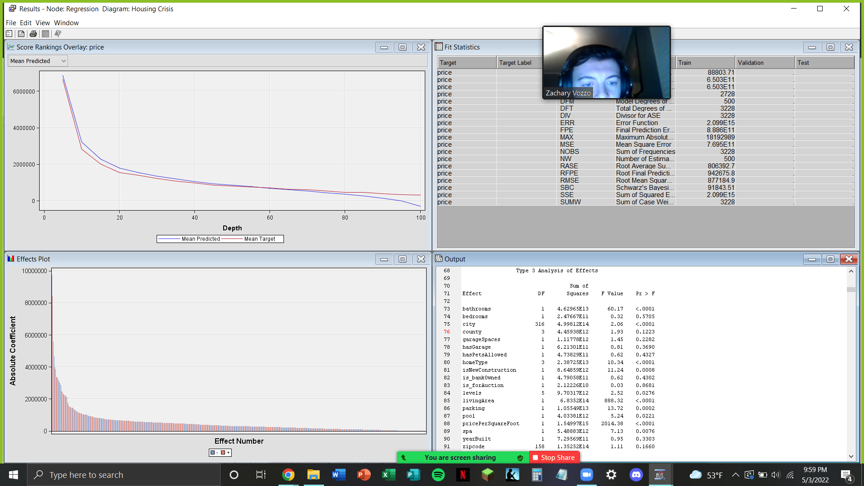
Linear Regression Output
Notes:
Ariel

Slide 14
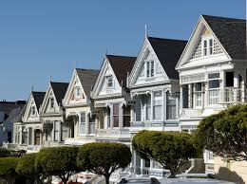
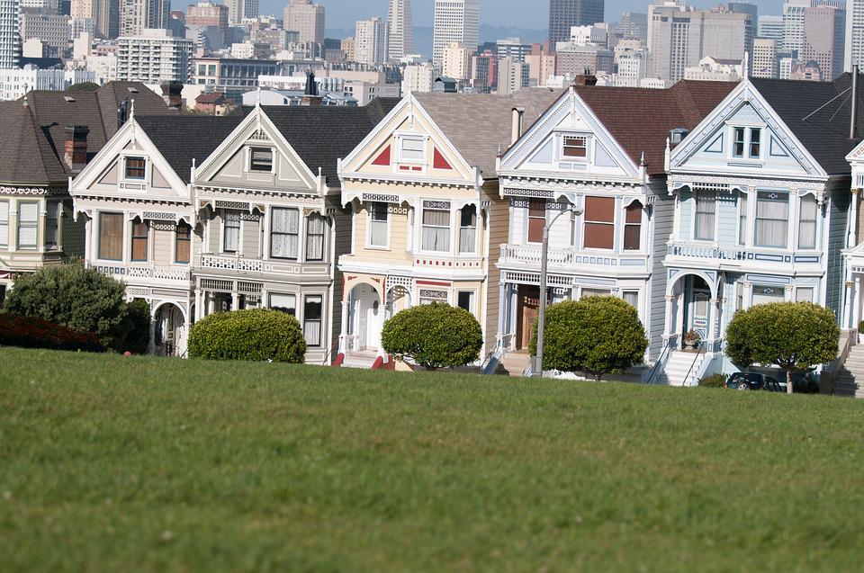
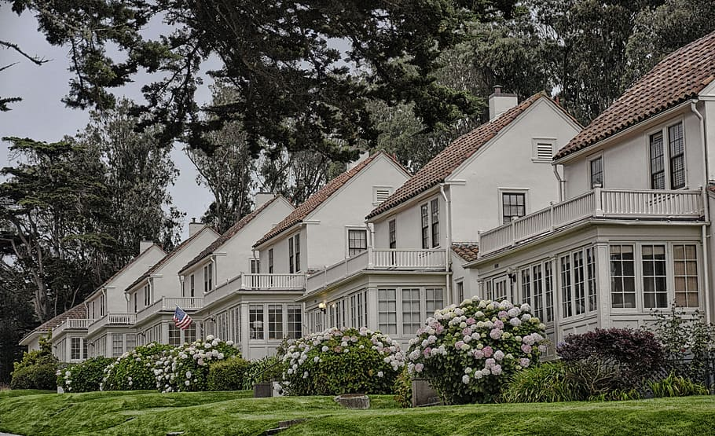
Cluster Analysis
Most expensive characteristics:
4 bed/3 bath, garage accessibility, built in 1987+
4 reasonable unique clusters generated
Most prominent housing available, most expensive
Notes:
Ariel

Slide 15
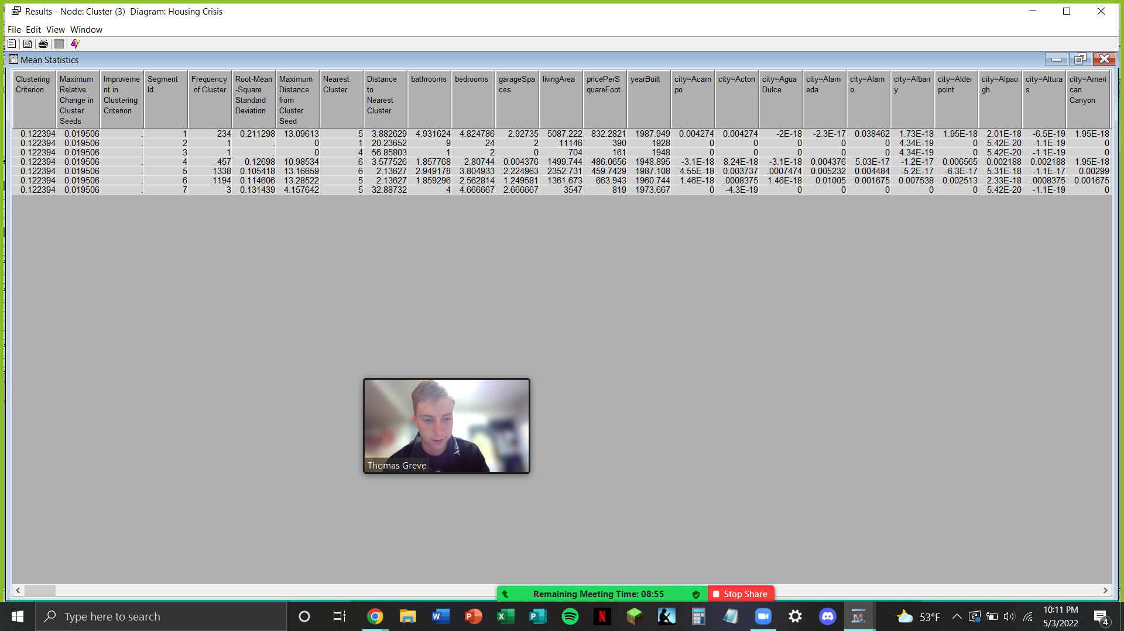
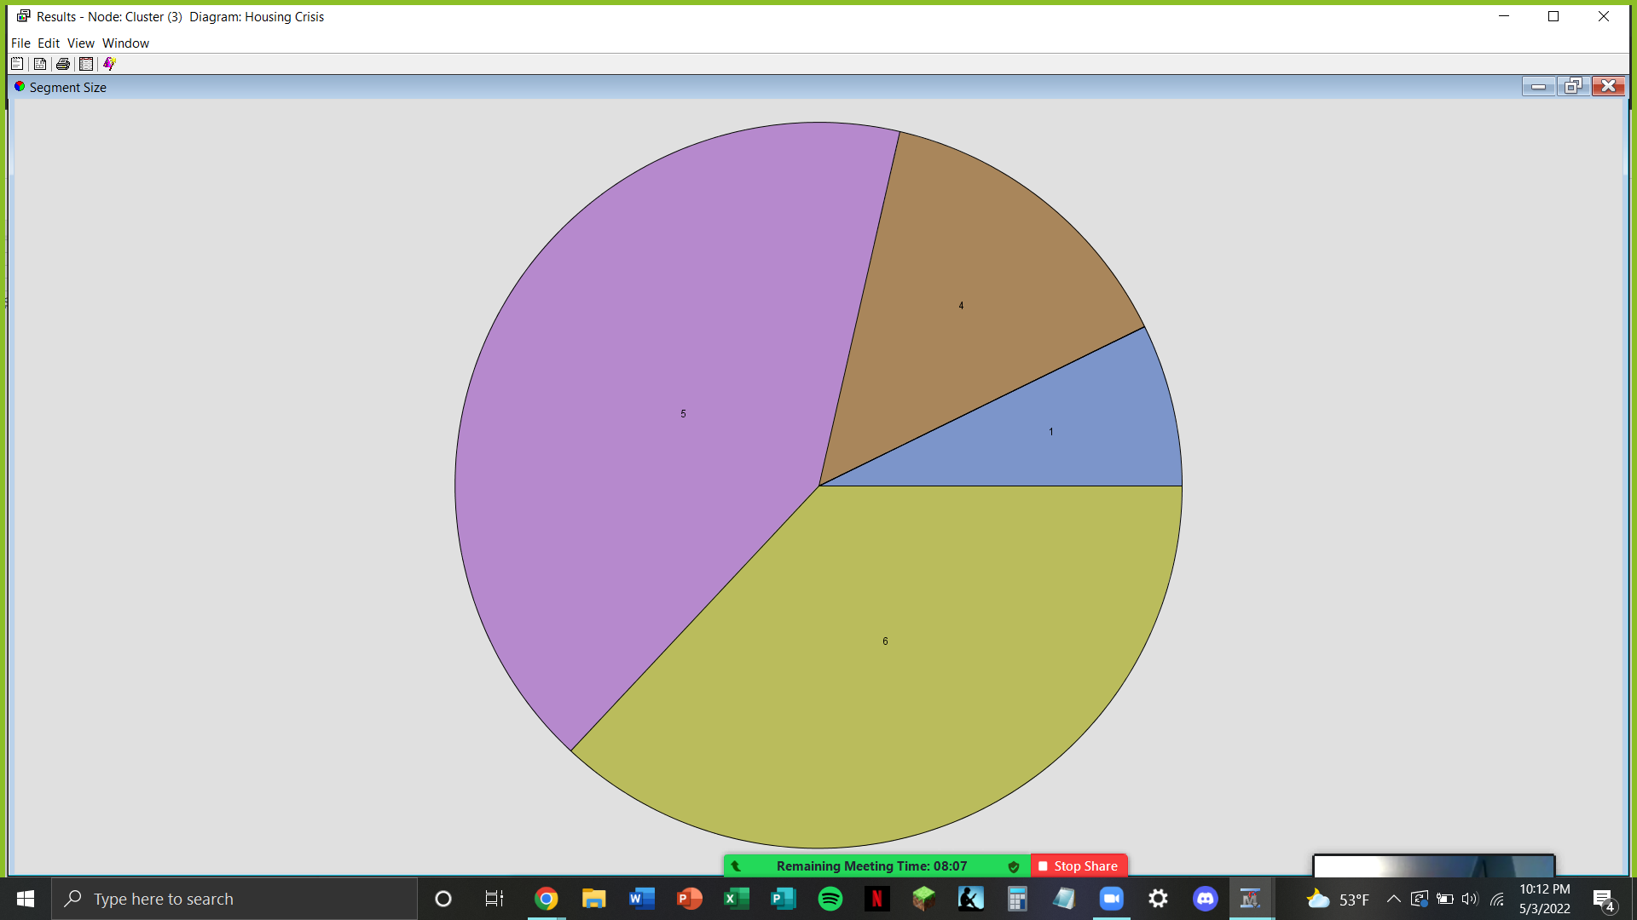
Cluster Analysis Output
Centroid clustering method:
- Cluster 1: newer houses with 5+ bed/bath
- Cluster 4: oldest/smallest living spaces
- Cluster 5: newer/moderately sized houses
- Cluster 6: newer and smaller living spaces
Notes:
Ariel

Slide 16
Decision Tree Analysis
Utilized binary variables to predict house price ranges
4 significant variables:
Spa
Pool
Parking
isNewConstruction
6 tree nodes produced
Notes:
Ariel

Slide 17
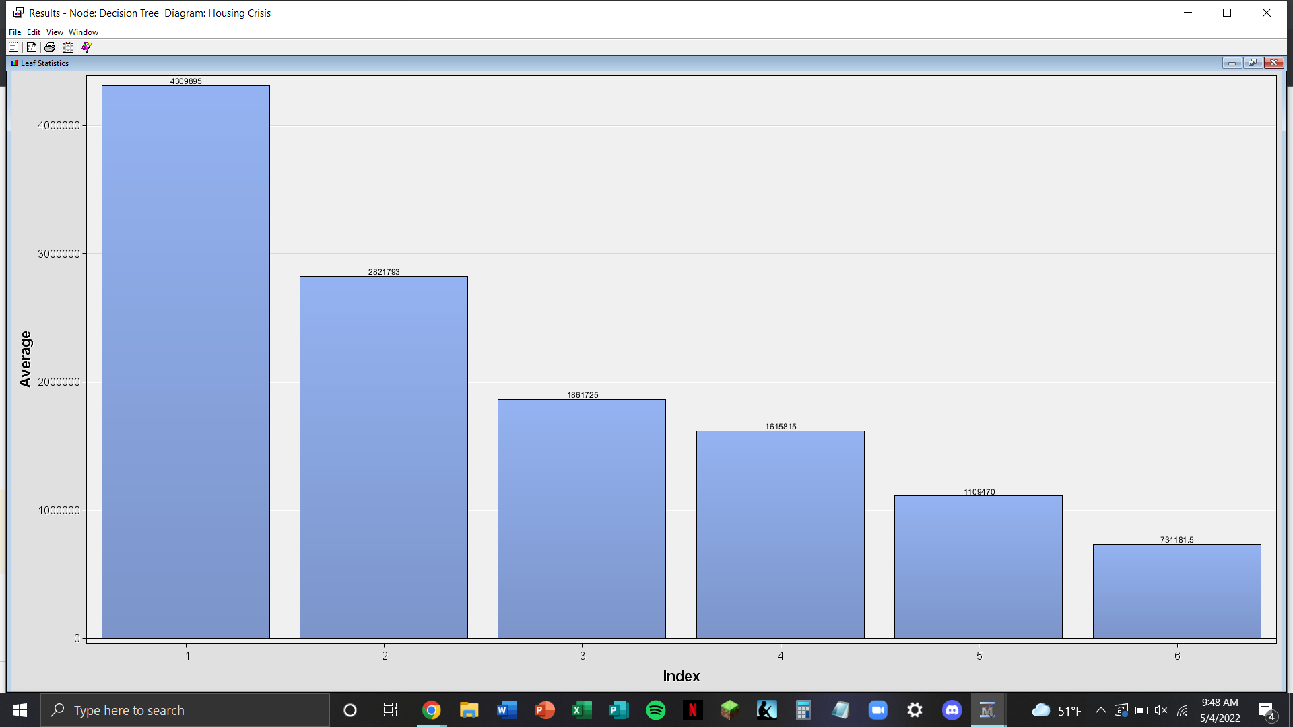
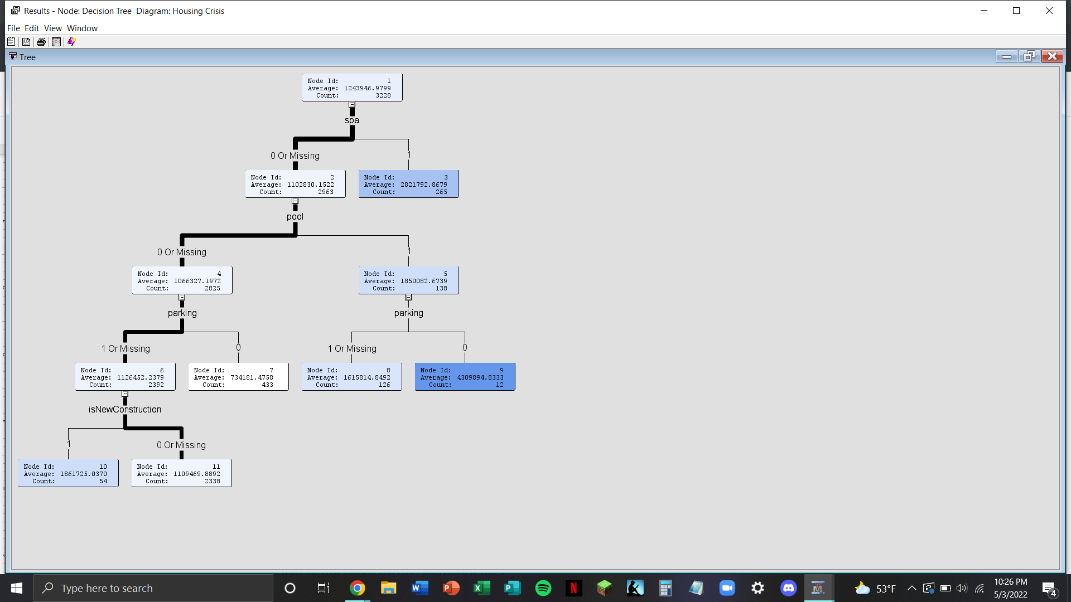
Decision Tree Output
Notes:
Ariel

Slide 18

Results and Findings
Expensive homes include certain amenities that drive up their price.
Properties tend to be small and expensive, compared to Pennsylvania. (Price per square foot in the data is quite high at $566 versus $151)
Certain amenities are more valuable and have a greater indication of the price than others
Notes:
Zach

Slide 19
Managerial Implications and Conclusion
Eliminate the “extras” when possible.
Home buyers might want to purchase a “fixer upper”
Understand that there are more individuals than homes
More developers need to be drawn to the market
Further Research:
- Looking into different pricing based on location (diagnose areas where the inflation of houses is greater)
- Analysis of California housing prices over time
Notes:
Zach

